Slide 1



Financial_Analytics
View in Power BI
Last data refresh:
4/15/2024 5:21:23 AM UTC
Downloaded at:
4/15/2024 5:22:38 AM UTC

Slide 2
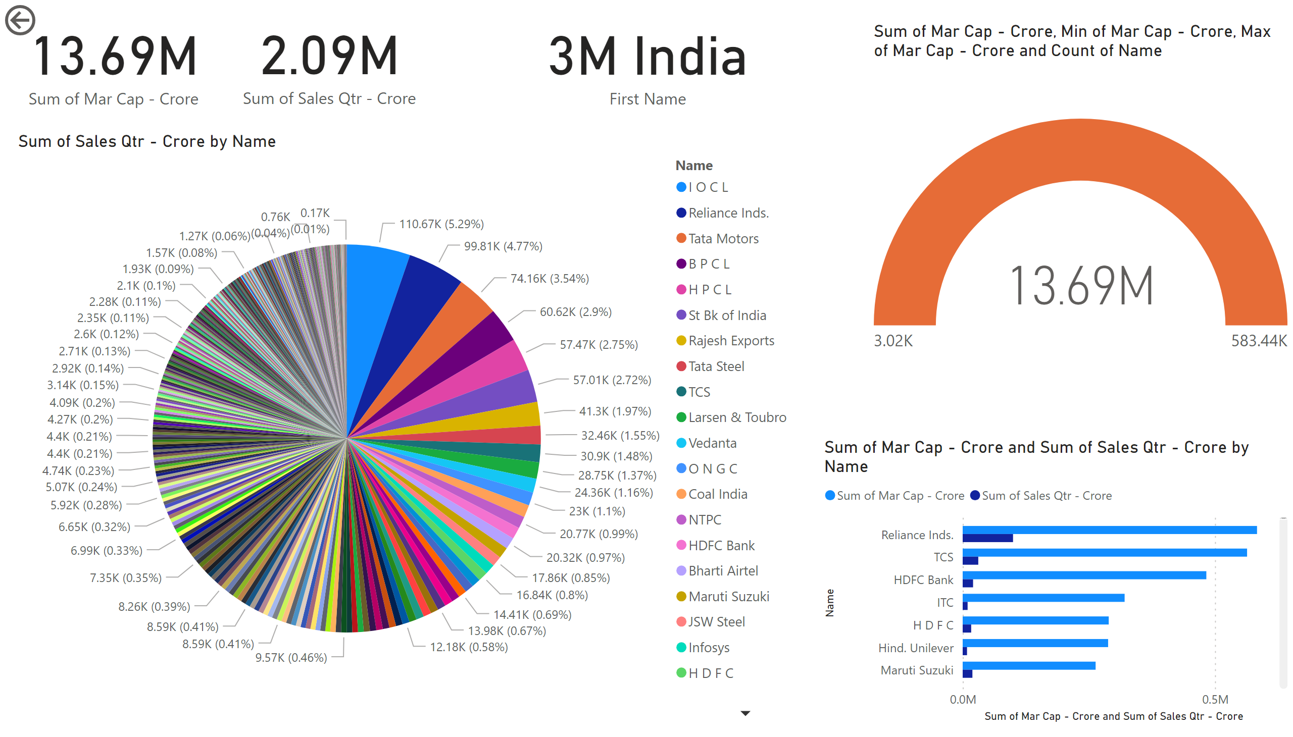
Page 1
Notes:
card
No alt text provided
actionButton
No alt text provided
card
No alt text provided
card
No alt text provided
clusteredBarChart
No alt text provided
pieChart
No alt text provided
gauge
No alt text provided

Slide 3
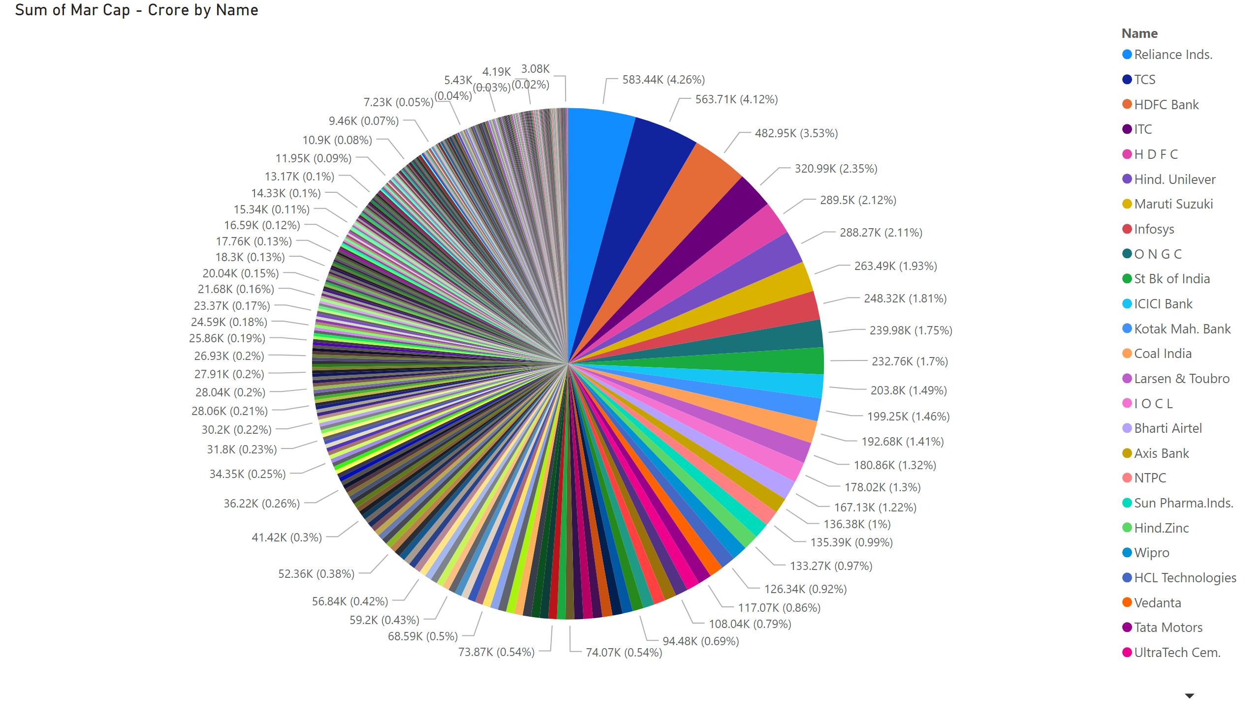
Page 2
Notes:
pieChart
No alt text provided

Slide 4
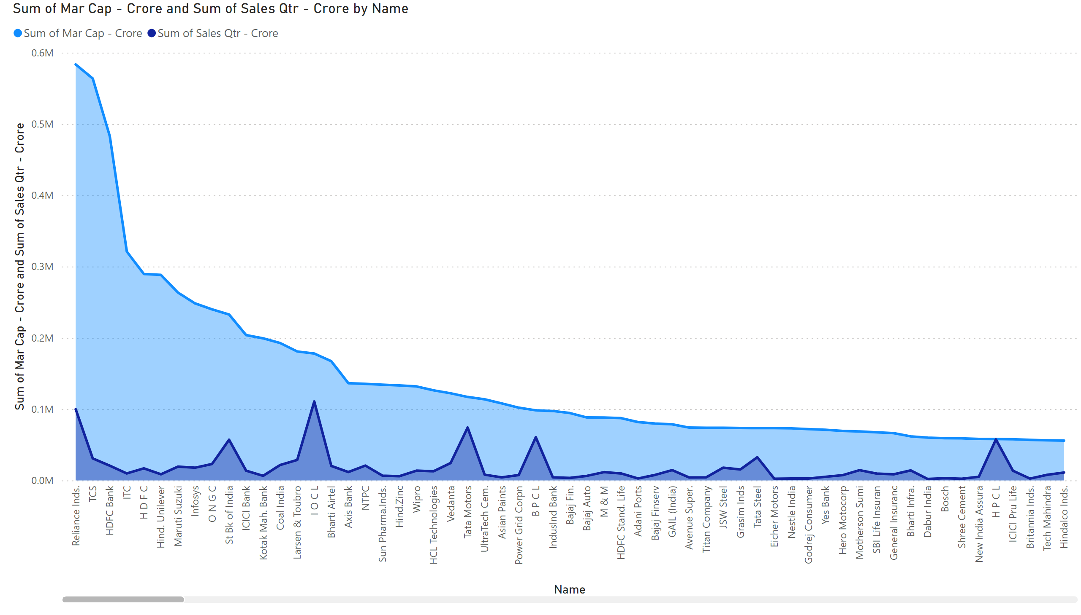
Page 3
Notes:
areaChart
No alt text provided

